Slide 1
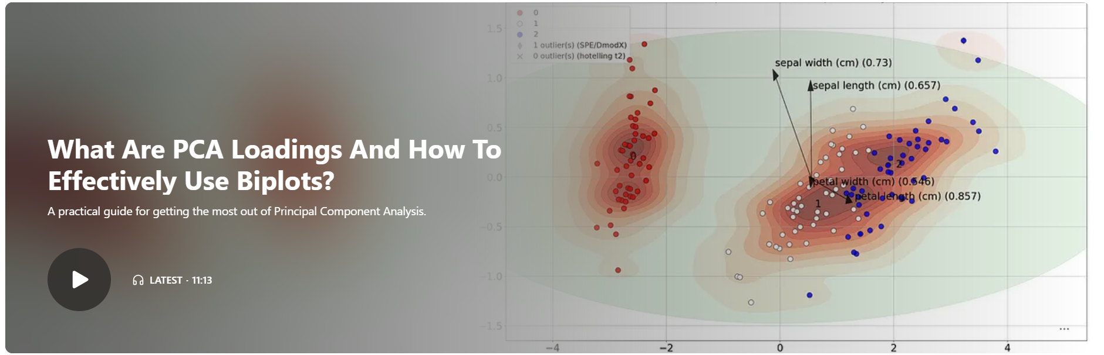

Slide 2



Outlier Detection Using Principal Component Analysis with Hotelling's T2 and SPE/DmodX Methods
Take advantage of the sensitivity of PCA: A step-by-step guide for outlier detection in multivariate datasets.
Podcast included

